Slide 1
School Nutrition
Finance in 2024
Janet W. Johnson, SNS
Assistant Director

Slide 2
A New Year Doesn’t Mean…
“Out with the Old, In with the New”

Slide 3
Today’s Menu Specials
Capital Expenditures
Equipment Disposition
FC-1A
Months Operating Balance
Indirect Cost

Slide 4
Capital Expenditure - Equipment
Requires State Agency approval PRIOR to purchase.
Required when the piece of equipment meets or exceeds the Fixed Asset Threshold – typically $5,000 but may be lower.
Submitted in the School Nutrition Technology System – Capital Expenditure Request

Slide 5
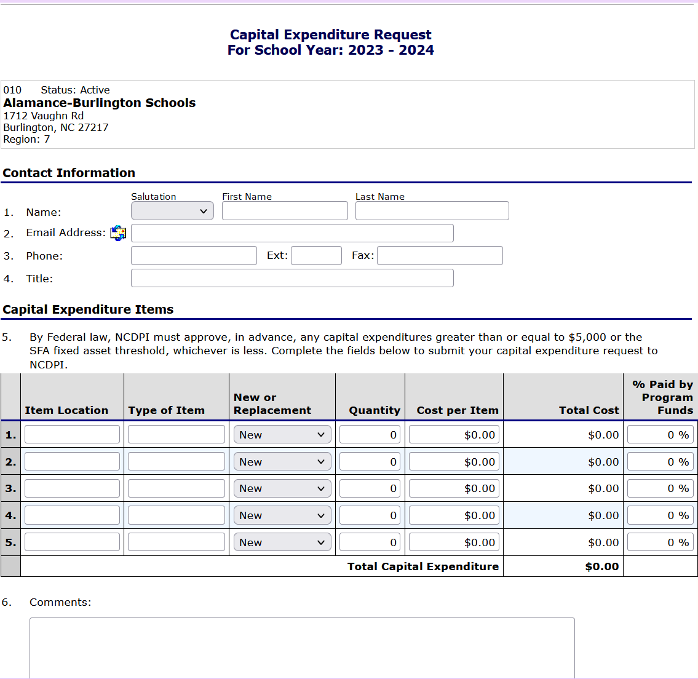

Slide 6
Capital Expenditure - Vehicle
Requires State Agency approval PRIOR to purchase.
Requires justification for the purchase.
Submitted to NCDPI in writing – email

Slide 7
Equipment Disposition
Notify State Agency of disposal of items
Complete the Disposition of Assets template and email to State Agency
Ensure that any proceeds from the sale or disposal of the equipment is deposited into the School Nutrition Account.

Slide 8
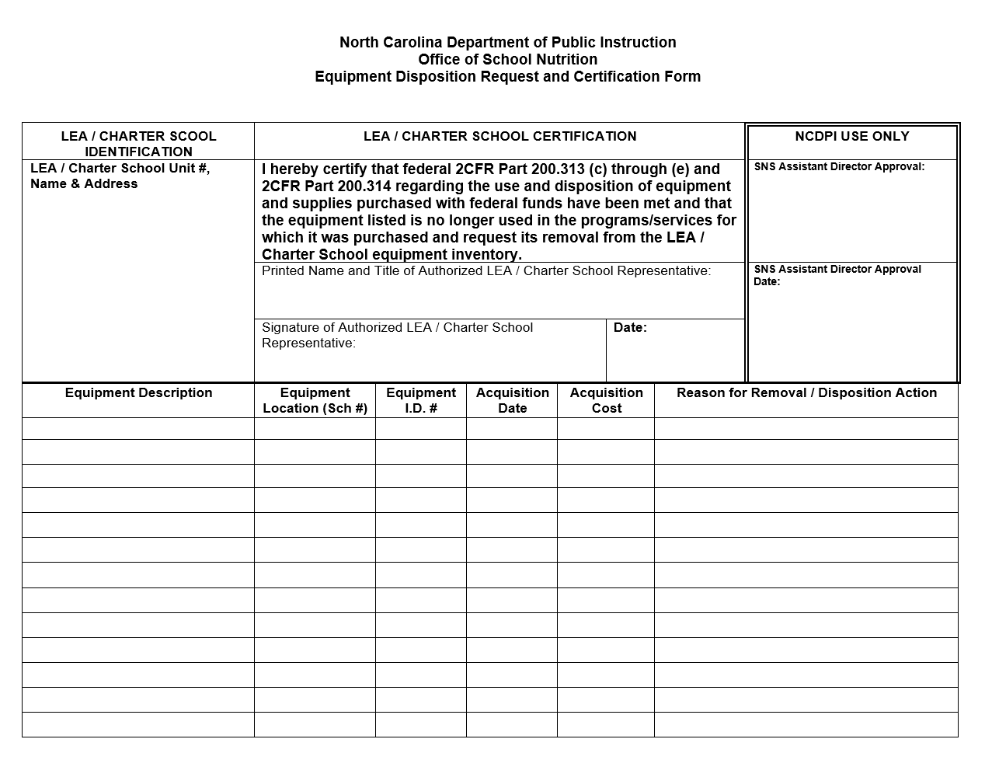

Slide 9
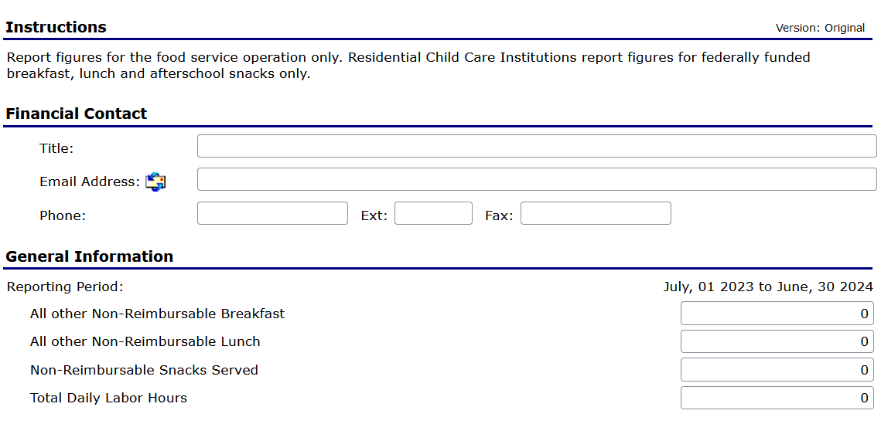
FC1-A

Slide 10
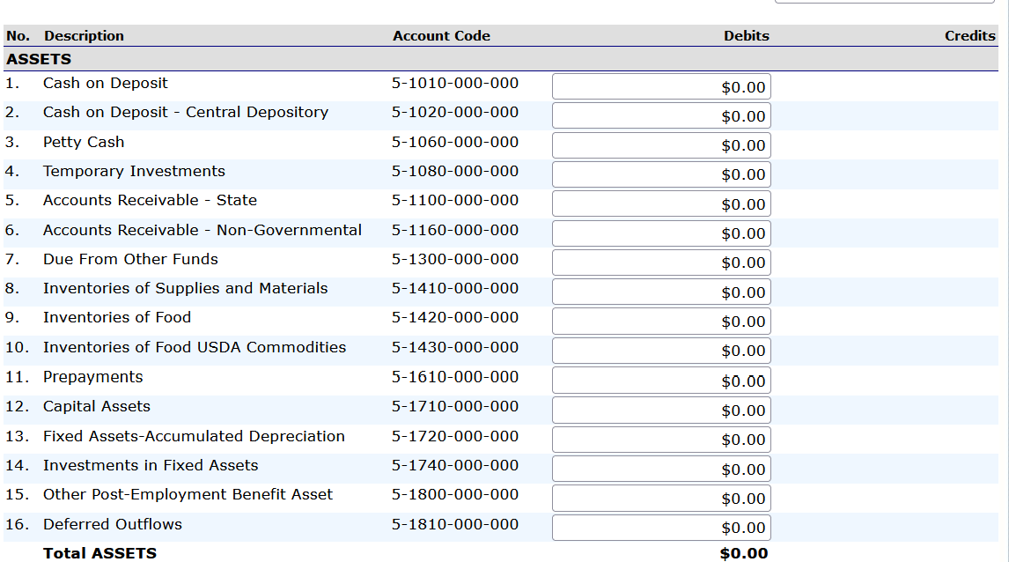

Slide 11
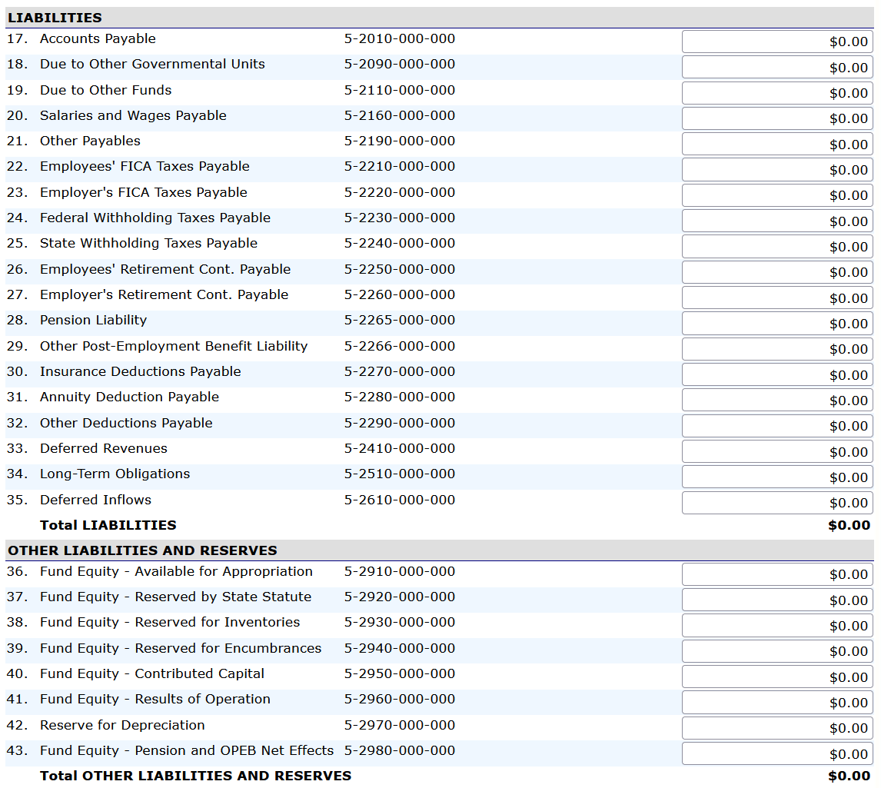

Slide 12
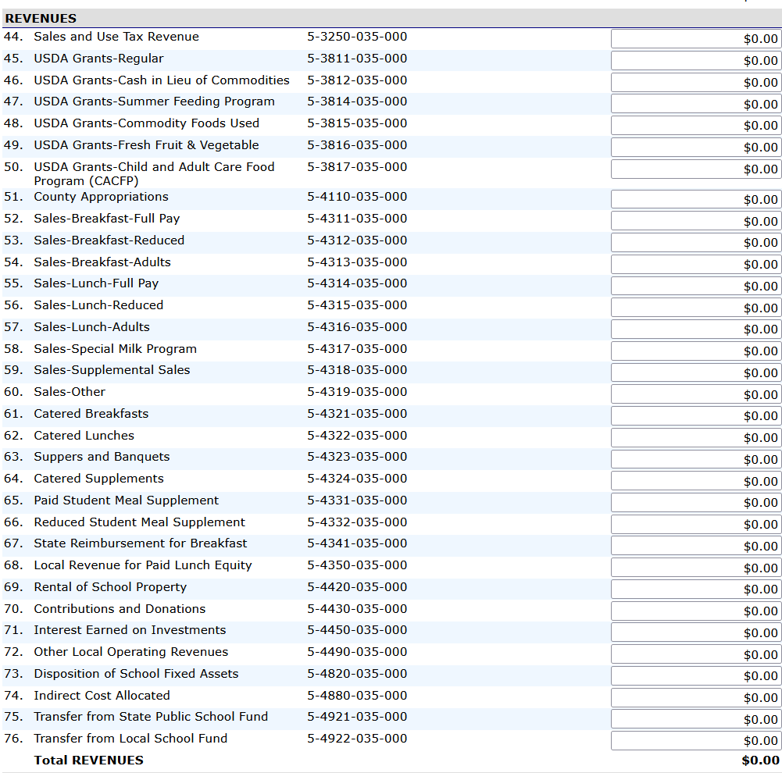

Slide 13
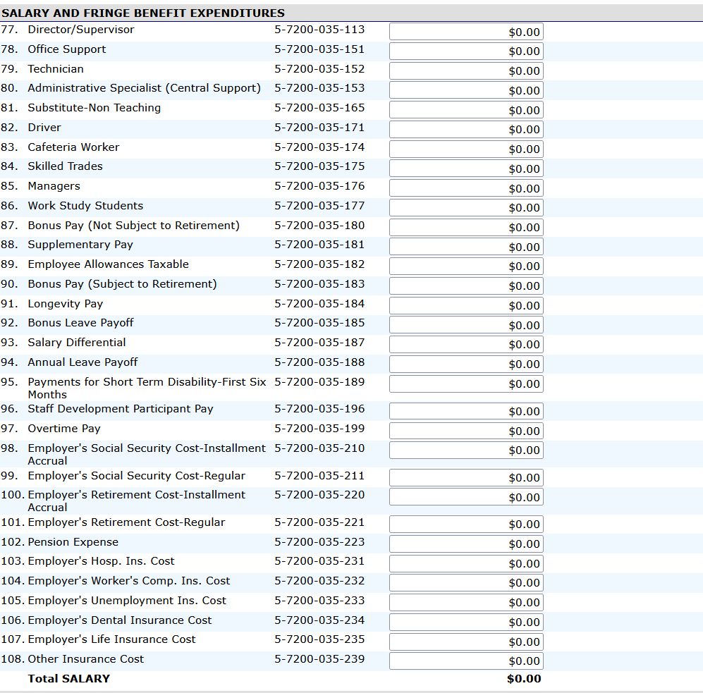

Slide 14
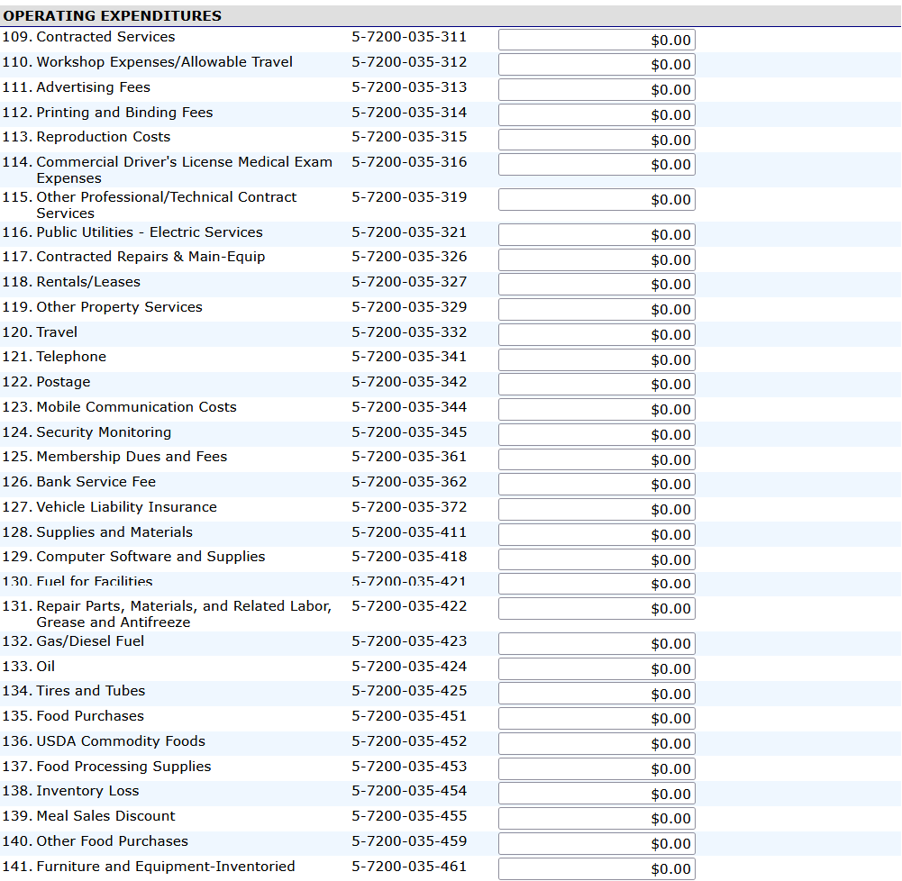

Slide 15
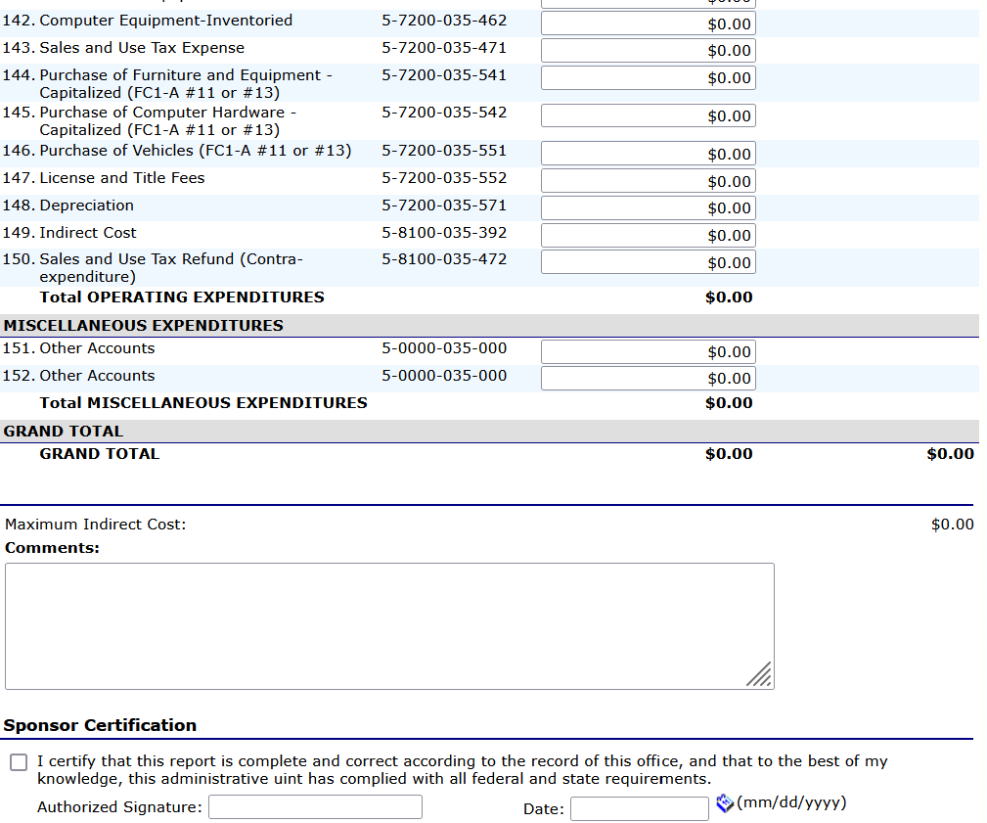

Slide 16
Months Operating Balance
The number of months the school nutrition program can meet financial obligations before local funds are required.

Slide 17
Months Operating Balance - Calculation
  Calculate Net Cash Resources
  Determine Average Monthly Expenses
  Divide Net Cash Resources by Average Monthly Expenses

Slide 18
Net Cash Resources
  Reflects the amount of available cash once all liabilities have been “paid”.

Slide 19
Net Cash Resources - Calculation
  Step 1: Add the totals reported in account codes
  5-1010 – Cash on Deposit
  5-1020 – Cash on Deposit – Central Depository
  5-1060 – Petty Cash
  5-1080 – Temporary Investments

Slide 20
Net Cash Resources - Calculation
  Step 2: Determine Total Liabilities
  Exclude the following:
  5-2265 – Pension Liability
  5-2266 – OPEB Liability
  5-2610 – Deferred Inflows

Slide 21
Average Monthly Expenses
  Determine the total expenses for the reporting period
  Determine # of Months – total serving days divided by 20
  Divide total expense by # of months
  *NOTE: June is based on 9 months

Slide 22
Number of Months Operating Balance
  Divide Net Cash Resources by Average Monthly Expense

Slide 23
Example
  Total Cash 500,000
  Total Liabilities 25,000
  Net Cash Resource 475,000
  Total Expenses (June) 2,000,000
  Average Expense 222,222
  # Months Operating 2.138

Slide 24
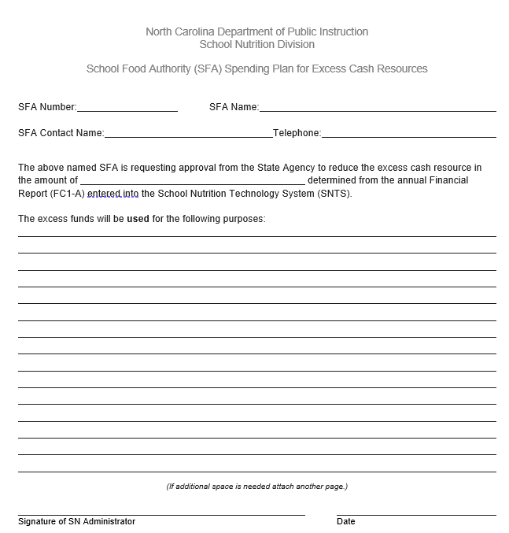
Spend Down Plan

Slide 25
INDIRECT COST
Must have at least 2 Months Operating Balance based on the most recent June FC1-A
Maximum Indirect Cost Rate allowed is 8.0%
Must be appropriately recorded in the general ledger at the end of the school year for payment to made to the local board of education in the next school year.

Slide 26
INDIRECT COST
Allowable only on these expenses:
Salaries & Fringe Benefits (Codes 100’s & 200’s)
Workshop Expenses/Allowable Travel (312)
Travel (332)
Supplies and Materials (411)

Slide 27
Questions???

Slide 28

In accordance with federal civil rights law and U.S. Department of Agriculture (USDA) civil rights regulations
and policies, this institution is prohibited from discriminating on the basis of race, color, national origin, sex
(including gender identity and sexual orientation), disability, age, or reprisal or retaliation for prior civil rights
activity.
Program information may be made available in languages other than English. Persons with disabilities who require
alternative means of communication to obtain program information (e.g., Braille, large print, audiotape, American
Sign Language), should contact the responsible state or local agency that administers the program or USDA’s
TARGET Center at (202) 720-2600 (voice and TTY) or contact USDA through the Federal Relay Service at (800)
877-8339.
To file a program discrimination complaint, a Complainant should complete a Form AD-3027, USDA Program
Discrimination Complaint Form which can be obtained online
at: https://www.usda.gov/sites/default/files/documents/ad-3027.pdf, from any USDA office, by calling (866) 632-
9992, or by writing a letter addressed to USDA. The letter must contain the complainant’s name, address,
telephone number, and a written description of the alleged discriminatory action in sufficient detail to inform the
Assistant Secretary for Civil Rights (ASCR) about the nature and date of an alleged civil rights violation. The
completed AD-3027 form or letter must be submitted to USDA by:
mail:
U.S. Department of Agriculture
Office of the Assistant Secretary for Civil Rights
1400 Independence Avenue, SW
Washington, D.C. 20250-9410; or
fax:
(833) 256-1665 or (202) 690-7442; or
email:
Program.Intake@usda.gov
This institution is an equal opportunity provider.
125
Notes:
[Non-discrimination statement]

